Slide 1
Trains vs Planes: The True Cost of Travel
Makeover Monday
Suyin Lee & Andreas Lezis

Slide 2
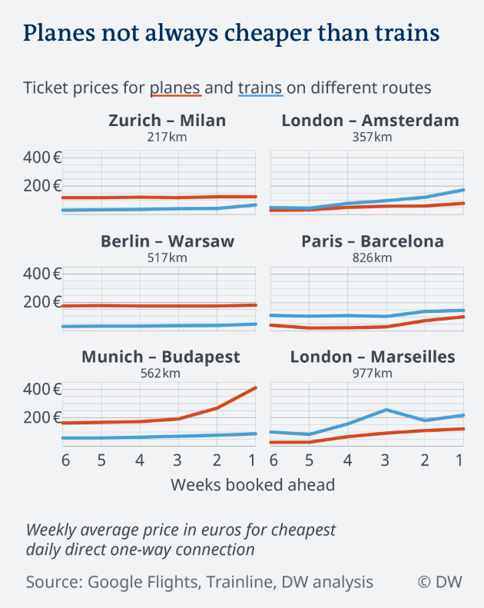
Original Visualization
Examines monetary cost of travel (vertical axis) as a function of number of weeks booked ahead (horizontal axis)
Faceted by six Origin-Destination dyads
Colored by mode of travel (red = plane and train = blue)
Note the fifth variable: distance (km) between each Origin & Destination
Note the legend

Slide 3
Weaknesses of this visualization?
When were these data collected?
The vertical axis guidelines aren’t easy to read
The vertical dimension feels too compressed
Not clear how the facets are sorted (if they’re sorted at all)
Not clear where the data for the distance (km) represents, unknown source

Slide 4
Recreating the Original Visualization

Slide 5
Improving the Original Visualization

Slide 6
Challenges

Slide 7
Closing Thoughts

